Slide 1
Named Entity Recognition (NER) and Relationship Extraction (REL) using SpaCy
Ishan Borker

Slide 2
CONTENTS
Introduction on SpaCy
Dataset Information
Procedure to generate SpaCy data
Testing SpaCy data
Named Entity Recognition (NER) Calculation
Usage Of Different Transformers for NER
Relationship Extraction (REL) Calculation
Usage Of Different Transformers for REL
Loss Curve plots for each of the results
Conclusion

Slide 3
INTRODUCTION TO SPACY
SpaCy is a library for advanced Natural Language Processing
Built in Python and Cython
Has pretrained pipelines and supports tokenization
Features:
Tagging
Parsing
Named Entity Recognition
Text-Classification
Relationship Extraction
Multi-task learning with pretrained transformers

Slide 4
DATASET INFORMATION
Chia with scope dataset: Large, annotated corpus of clinical trial eligibility criteria dataset
Contains 4004 files
There are 4000 files of patient’s data
Each patient is having 4 files in inclusion and exclusion format and with .ann and .txt file extension
Contains 4 configuration files: annotation.conf, kb_shortcuts.conf, tools.conf, visual.conf
Includes 12,409 annotated eligibility criteria, represented by 41,487 distinctive entities of 15 entity types and 25,017 relationships of 12 relationship types
Ref: https://www.nature.com/articles/s41597-020-00620-0.pdf

Slide 5
PROCEDURE TO GENERATE SPACY DATA
Load the blank SpaCy model
Use chia_ner.tsv or chia_rel.tsv dataset for data preprocessing
Filter discontinuous rows and extract top 10 entities
Finding out missing entities
Finding out the failed entities in data due to index error
Filtering the rows in which no entities are present
Calculate total training entities, total label entities and total missed entities
Convert the processed ner or rel data into .spacy file using dump to disk

Slide 6
TESTING SPACY DATA
Load the chia_ner.spacy file using doc_bin
Split it into train, test and valid dataset in the ratio of 80:10:10
Using dump to disk, convert the split documents into their respective .spacy files like chia_ner_train.spacy, chia_ner_test.spacy and chia_ner_dev.spacy
Follow the same method for file chia_rel.spacy and generate chia_rel_train.spacy, chia_rel_test.spacy and chia_rel_dev.spacy
Pipelines used to train both the models:
Using tok2vec: [‘tok2vec’,’ner’] and [‘tok2vec’,’relation_extractor’]
Using transformers: [‘transformer’, ‘ner’] and [‘transformer’, ‘rel’]

Slide 7
NAMED ENTITY RECOGNITION (NER) CALCULATION
Data extraction task to find and store textual content into categories like person, organizations, locations, etc.
Entities present in chia dataset: Person, Condition, Scope, Value, Drug, Procedure, Measurement, etc.
Training the model on CPU inside the local anaconda setup
Traverse to directory chia_clinical_trials/projects/tutorials/ner_pytorch_medical and edit train, test and dev paths inside project.yml file
Use Pipeline = [‘tok2vec’, ‘ner’]
Use the train command to calculate NER F1, Precision and Recall scores
python -m spacy train ./configs/config.cfg --paths.train ./corpus/chia_ner_train.spacy --paths.dev ./corpus/chia_ner_dev.spacy

Slide 8
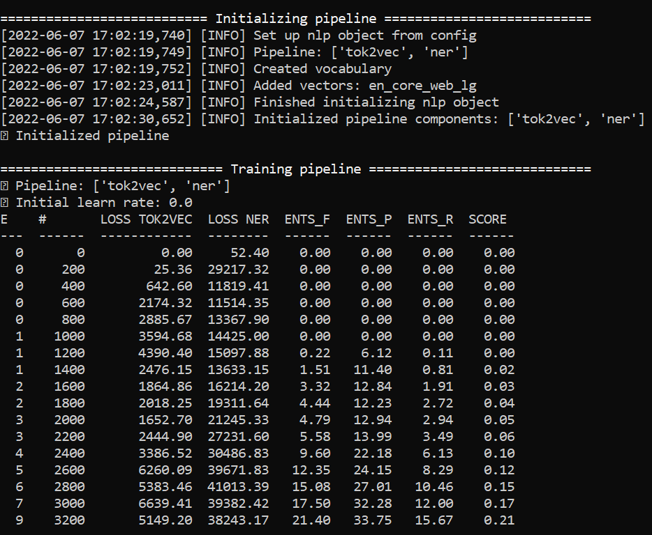

Slide 9
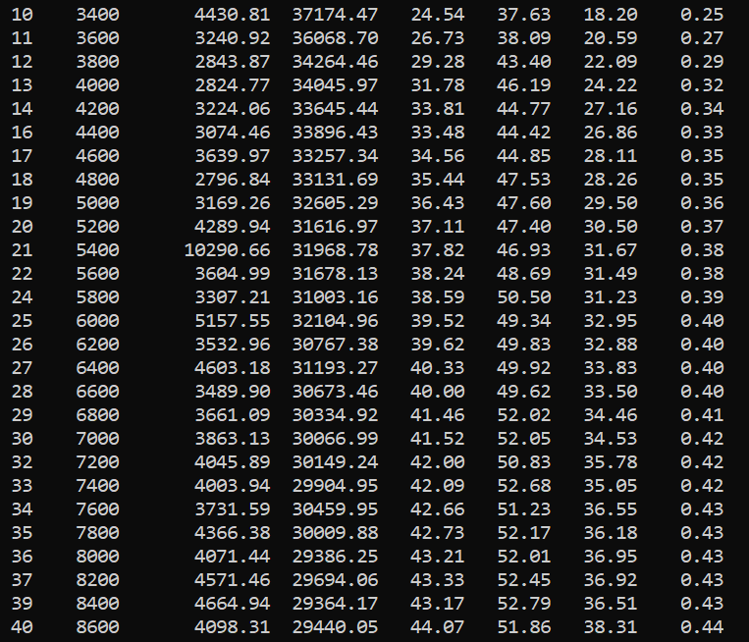

Slide 10
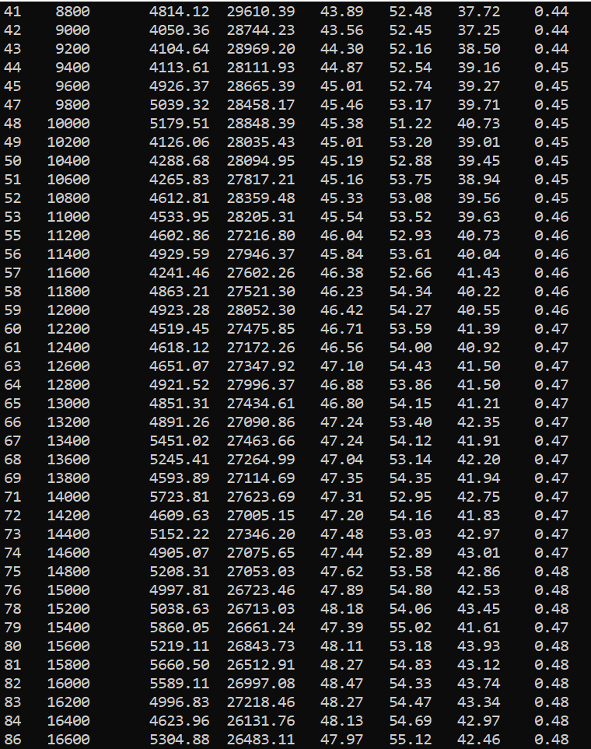

Slide 11
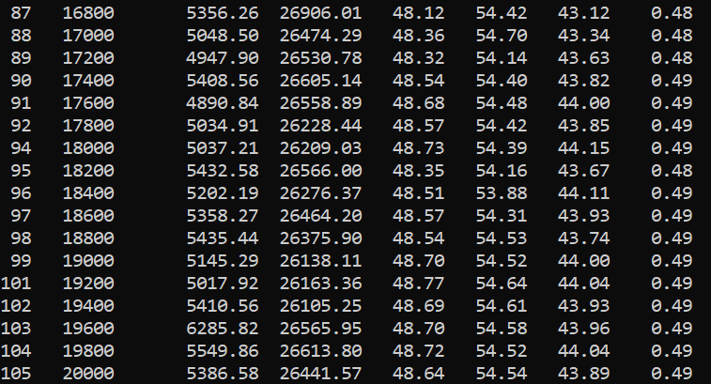

Slide 12
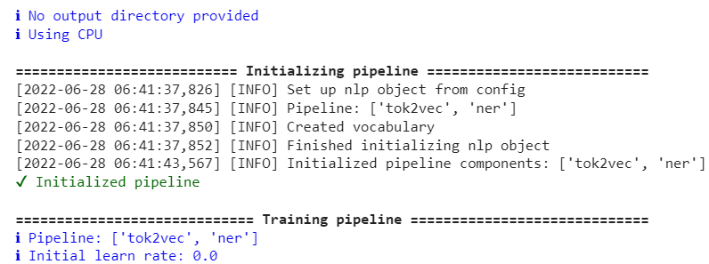
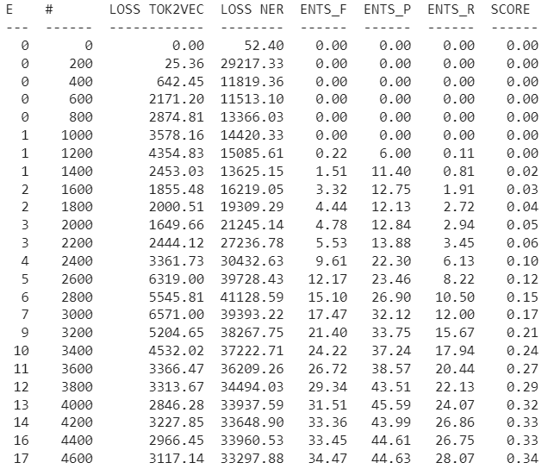
Training the NER model on CPU inside Google Colaboratory by setting the runtime type=‘CPU’

Slide 13
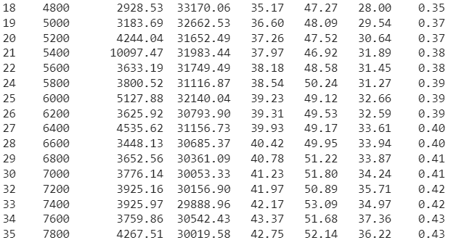
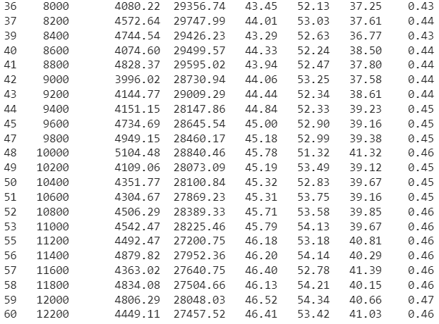

Slide 14
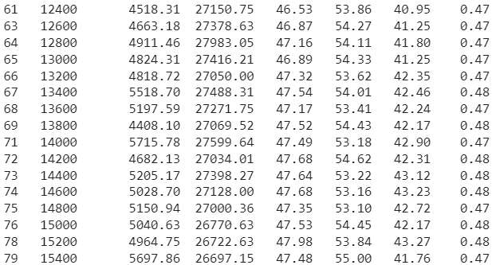
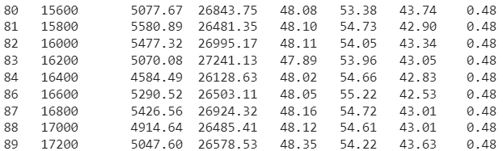
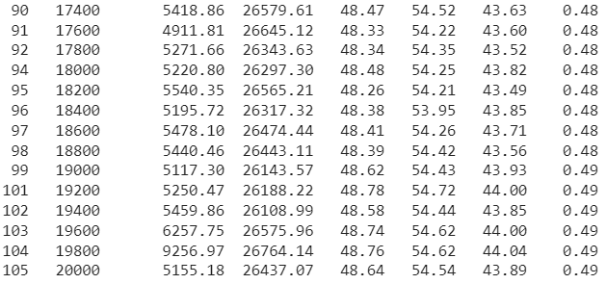

Slide 15
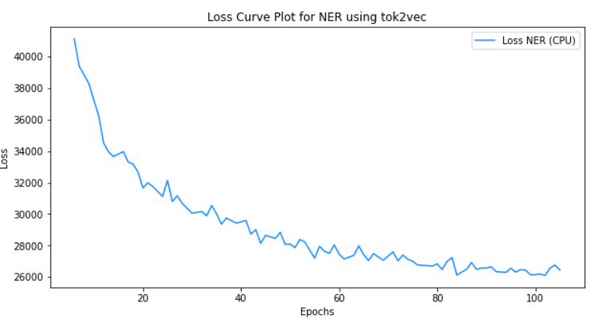
Loss Curve Plot for NER using tok2vec

Slide 16
USAGE OF DIFFERENT TRANSFORMERS FOR NER
Training the model on GPU inside Google Colab by setting the runtime type=‘GPU’
Install spacy-transformers
Use Pipeline = [‘transformer’, ‘ner’]
Go to /content/drive/MyDrive/chia_clinical_trials/projects/tutorials/ner_pytorch_medical/configs/ directory
Change transformer =‘roberta-base’ inside the config_trf.cfg file
GPU Results
python -m spacy train ./configs/config_trf.cfg --paths.train ./corpus/chia_ner_train.spacy --paths.dev ./corpus/chia_ner_dev.spacy --gpu-id 0

Slide 17
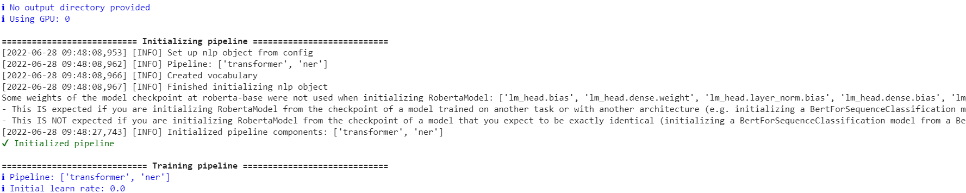
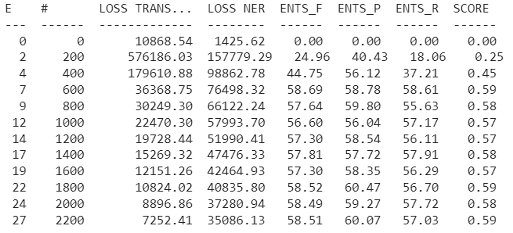

Slide 18
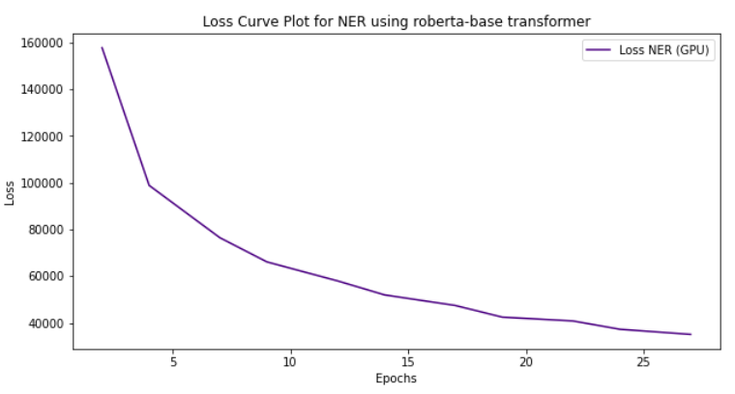
Loss Curve Plot for NER using roberta-base Transformer

Slide 19
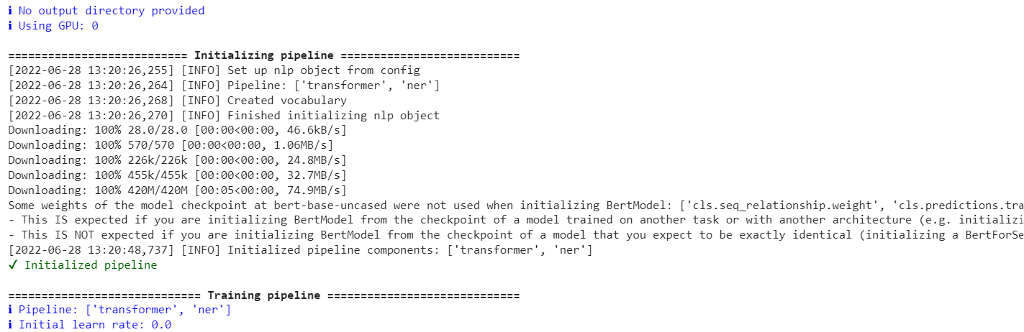
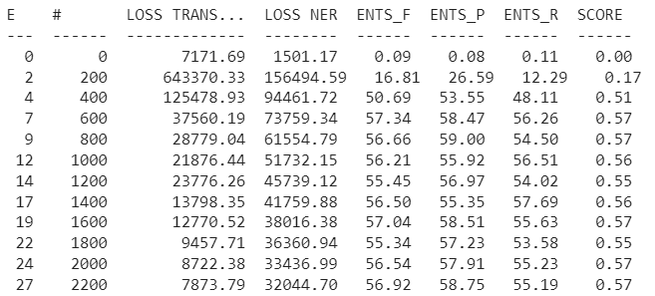
Change transformer =‘bert-base-uncased’ inside the config_trf.cfg file
GPU Results

Slide 20
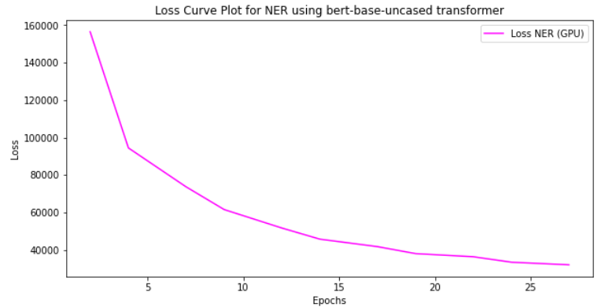
Loss Curve Plot for NER using bert-base-uncased Transformer

Slide 21
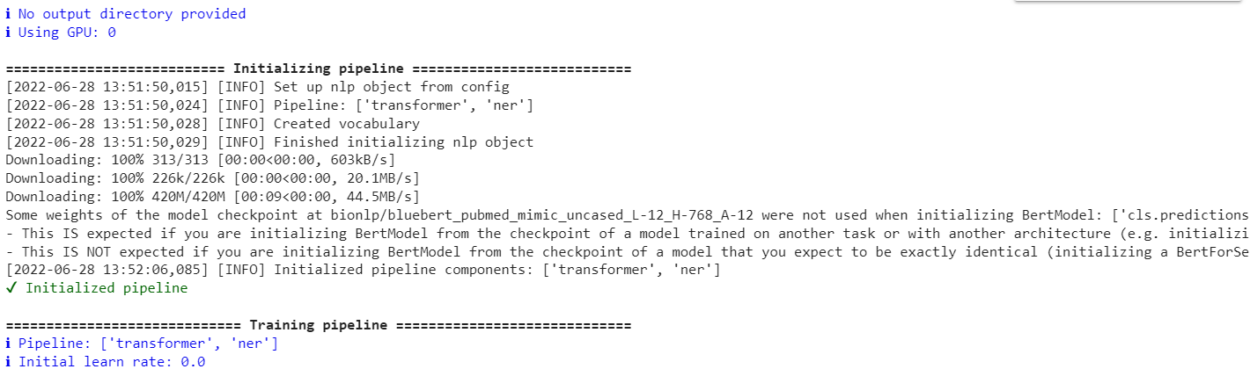
Change transformer =‘bionlp/bluebert_pubmed_mimic_uncased_L-12_H-768_A-12’ inside the config_trf.cfg file
GPU Results

Slide 22
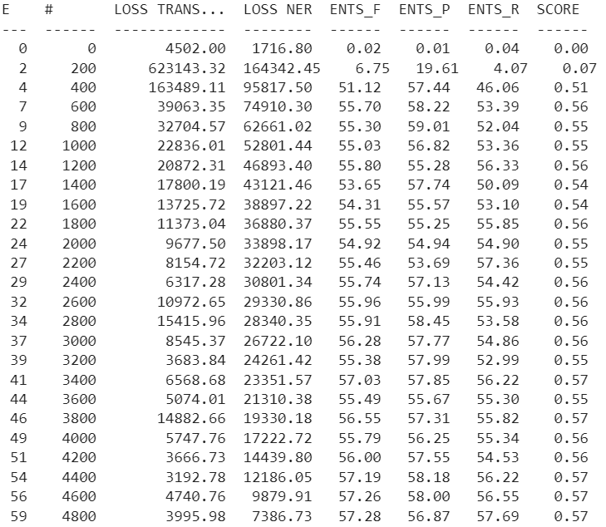
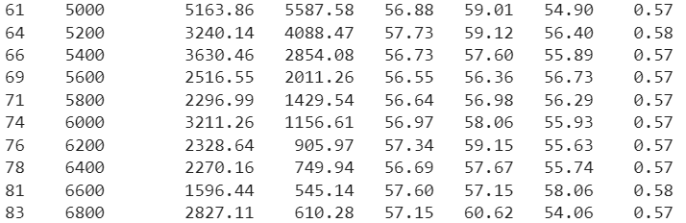

Slide 23
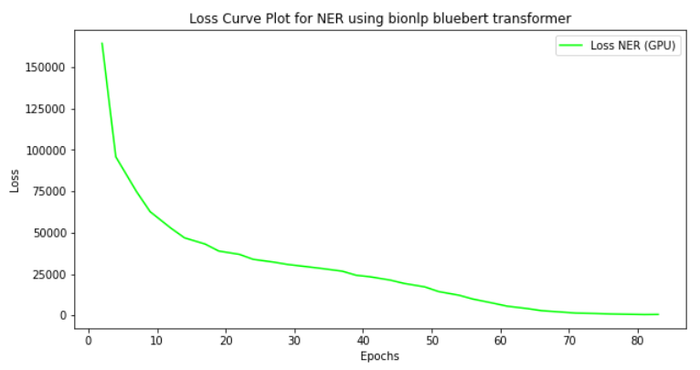
Loss Curve Plot for NER using bionlp bluebert Transformer

Slide 24
RELATIONSHIP EXTRACTION (REL) CALCULATION
Extracting semantic relationships from a text and occurs between two or more entities of a certain type
Go to chia_clinical_trials/projects/tutorials/rel_component/assets and include .ann files inside it
Edit the train, test and dev paths in project.yml file
Use Pipeline = [‘tok2vec’, ‘relation_extractor’]
Training the model on CPU inside the local anaconda setup
Use the train command to calculate REL F1, Precision and Recall scores
python -m spacy project run all
python -m spacy project run all_gpu

Slide 25
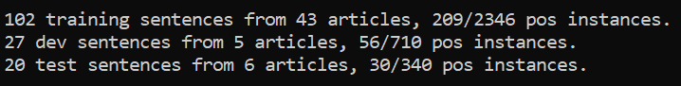
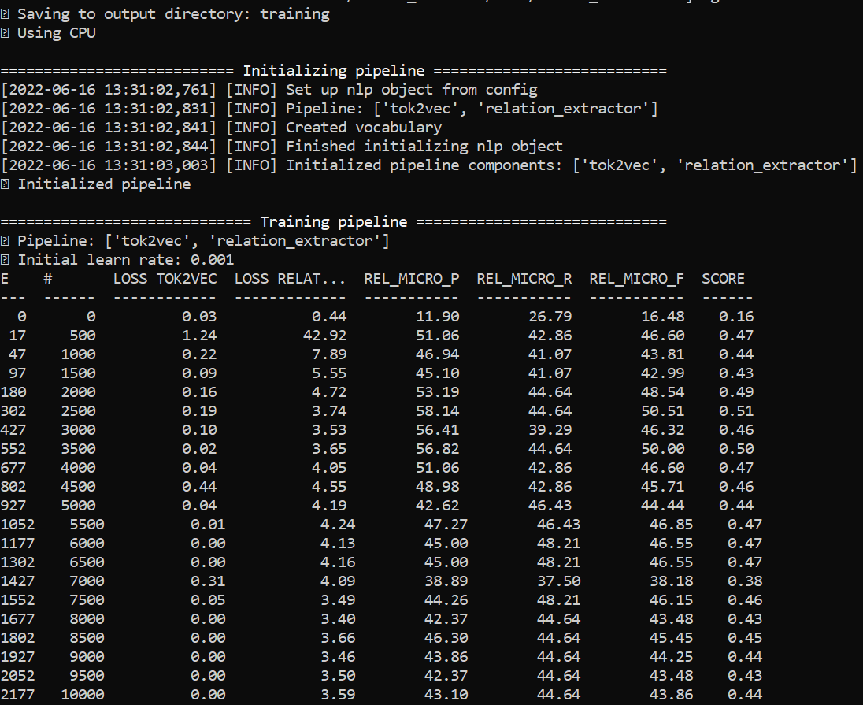
REL Results using train command

Slide 26
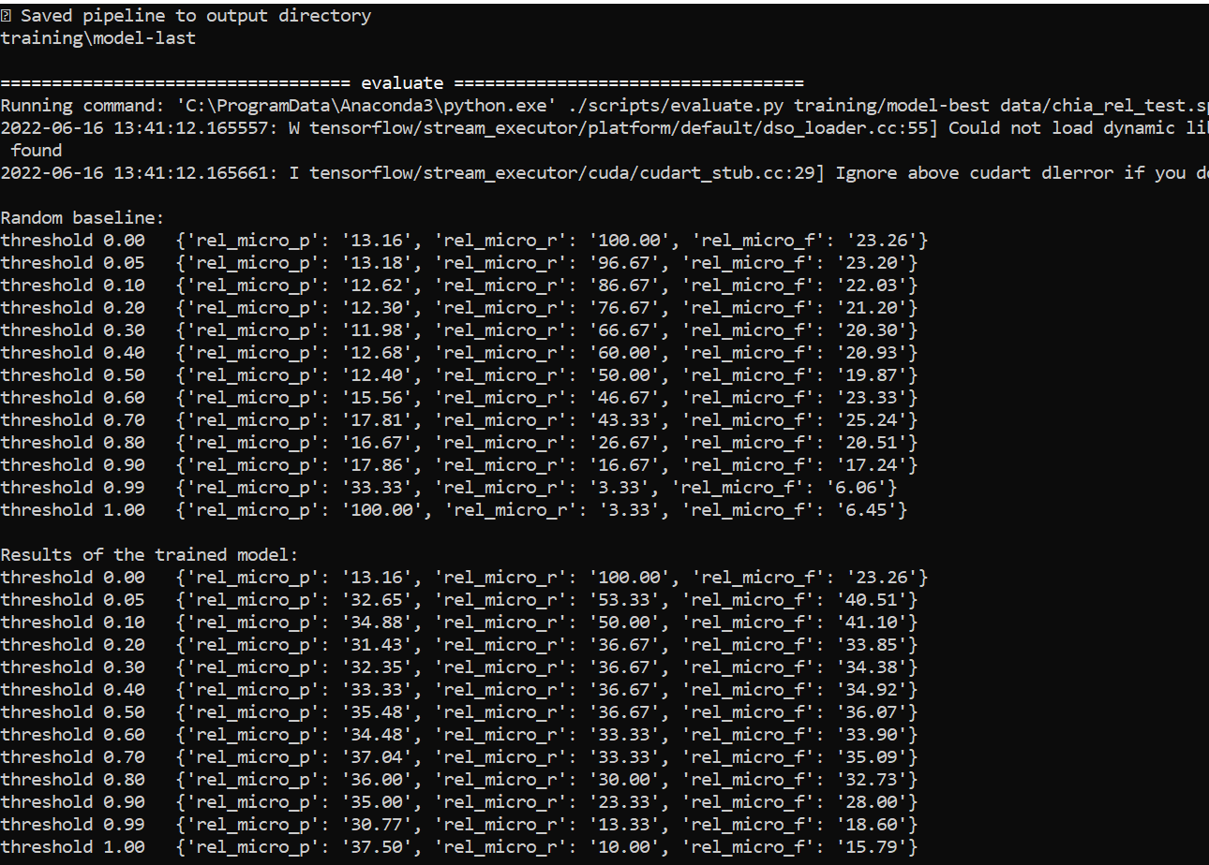

Slide 27
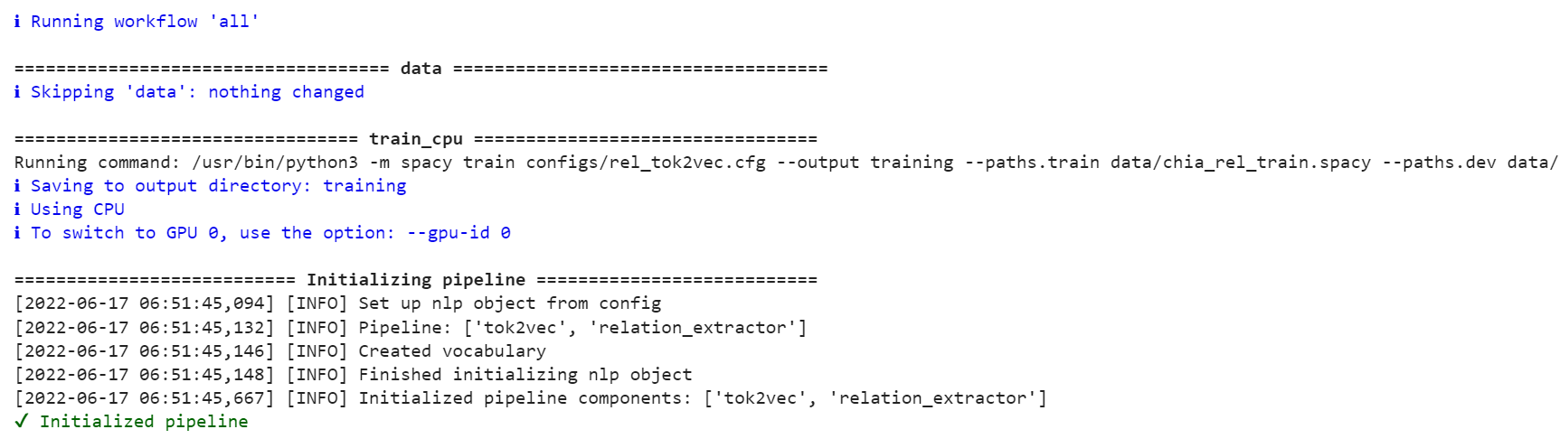
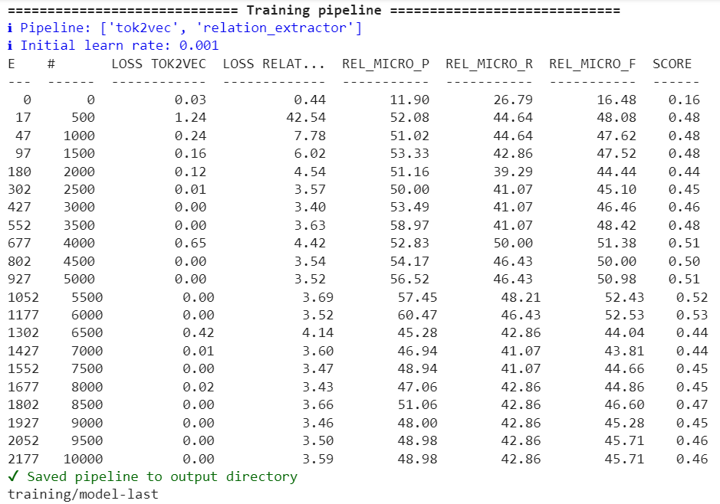
Training the REL model on CPU inside Google Colabatory by setting the runtime type=‘CPU’

Slide 28
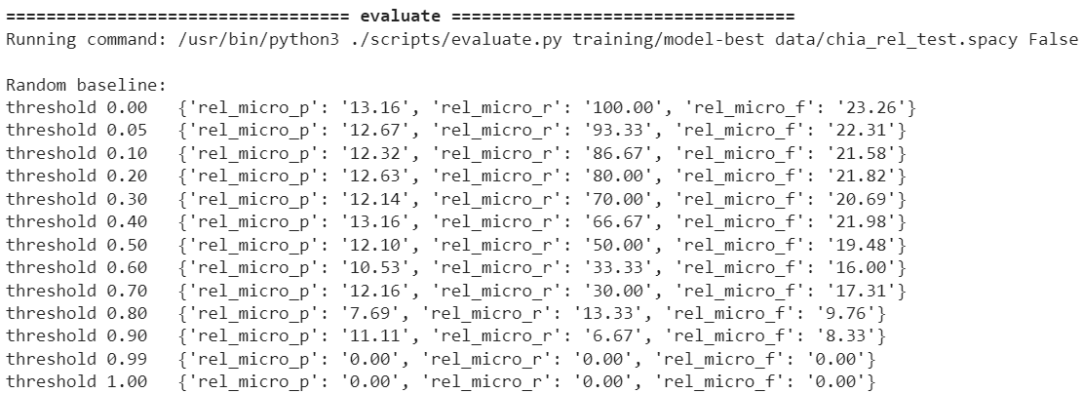
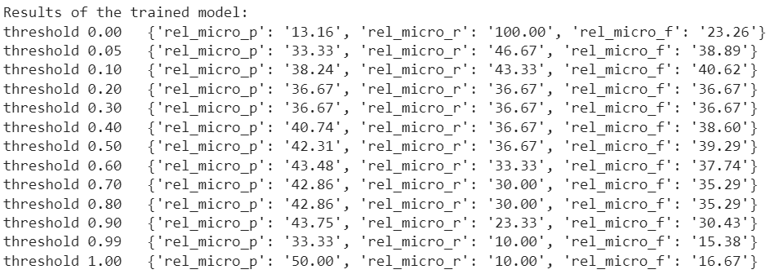

Slide 29
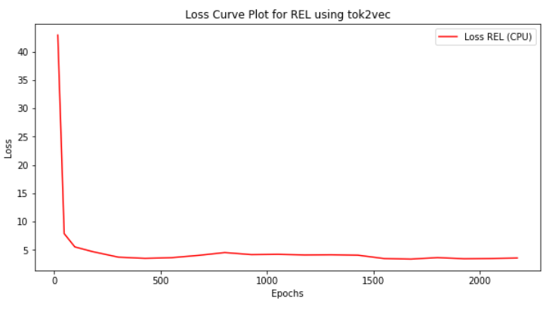
Loss Curve Plot for REL using tok2vec

Slide 30
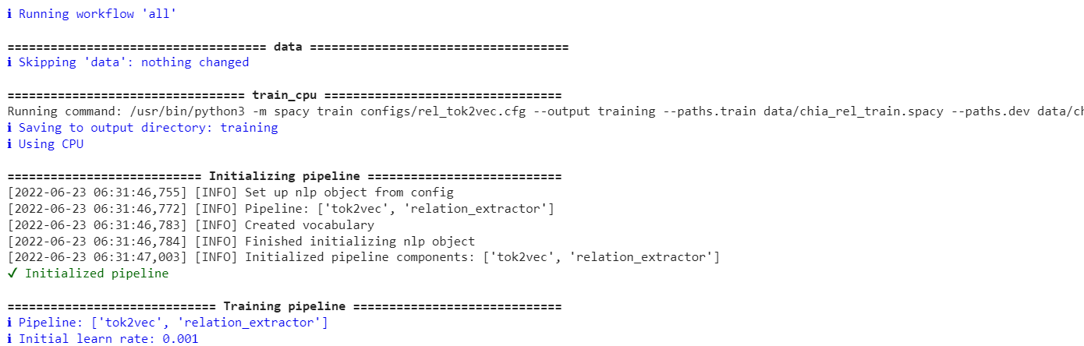
USAGE OF DIFFERENT TRANSFORMERS FOR REL
Training the model on GPU inside Google Colab by setting the runtime type=‘GPU’
Install spacy-transformers
Use Pipeline = [‘transformer’, ‘relation_extractor’]
Go to /content/drive/MyDrive/chia_clinical_trials/projects/tutorials/rel_component/configs/ directory
Change transformer =‘bert-base-uncased’ inside the rel_trf.cfg file
CPU Results

Slide 31
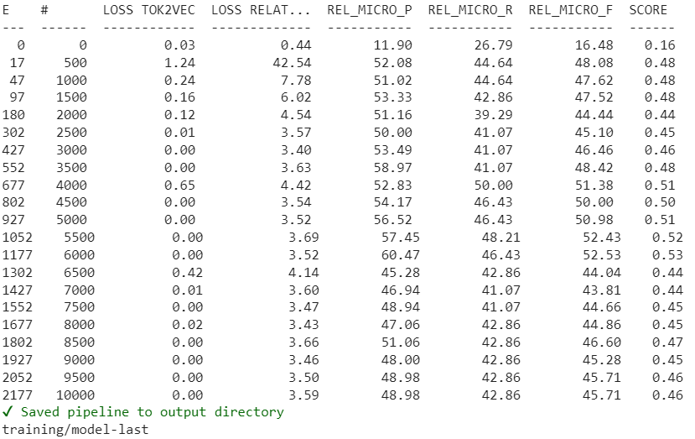
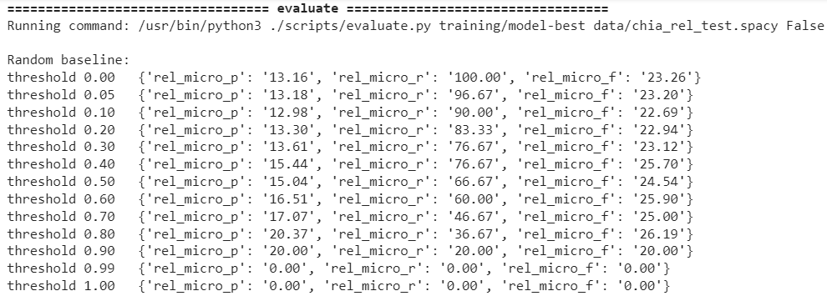

Slide 32
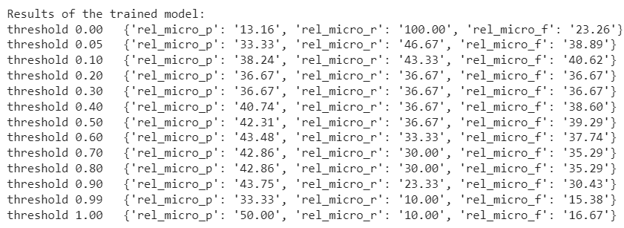
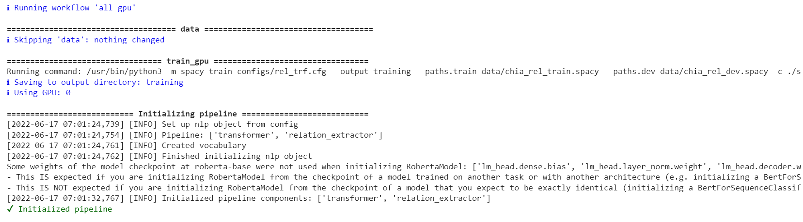
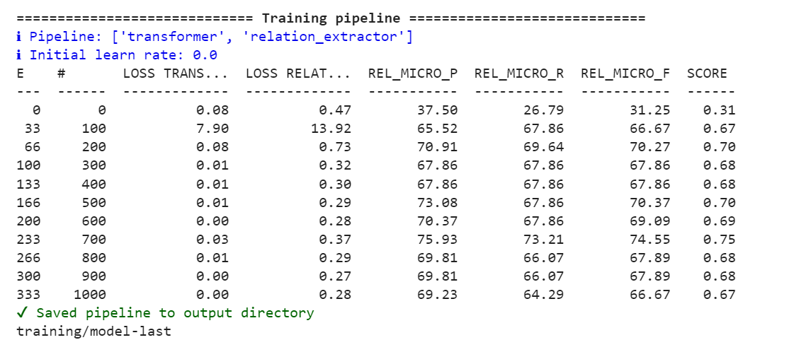
GPU Results

Slide 33
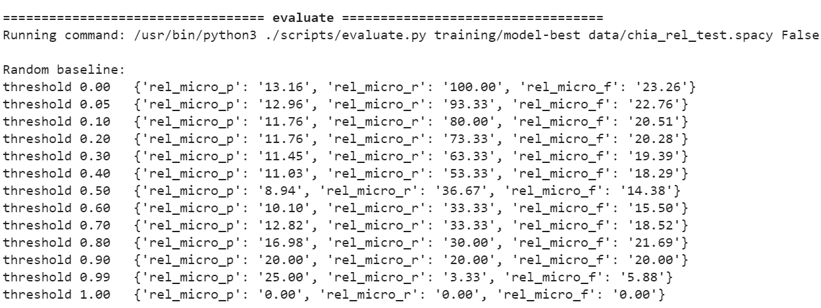
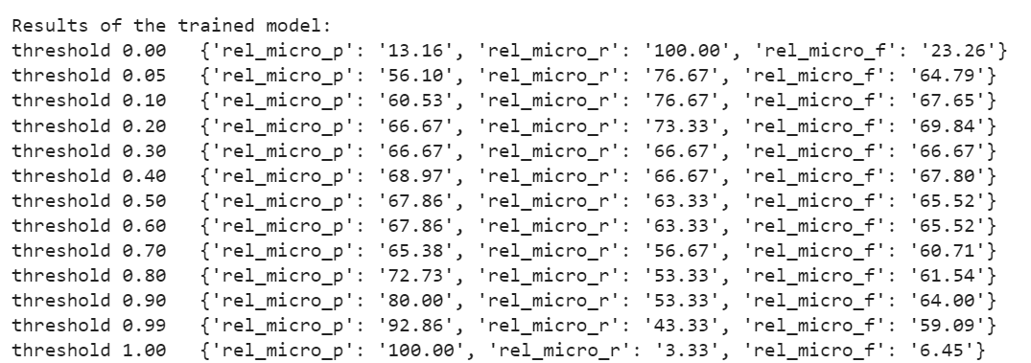

Slide 34
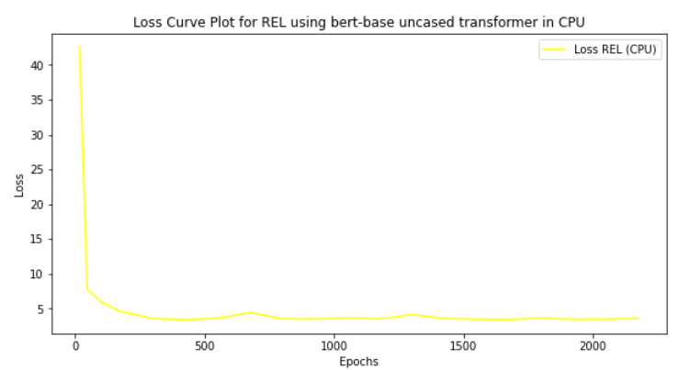
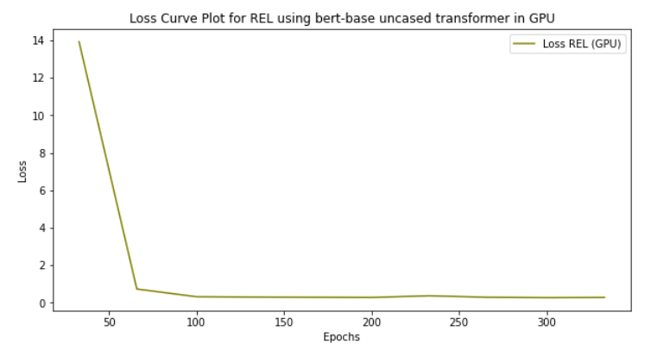
Loss Curve Plots for REL using bert-base uncased Transformer

Slide 35
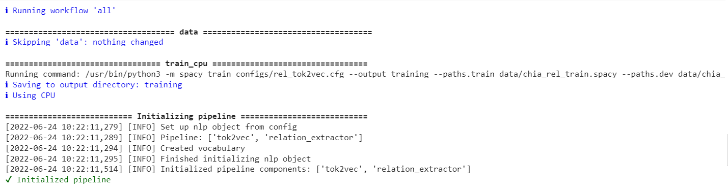
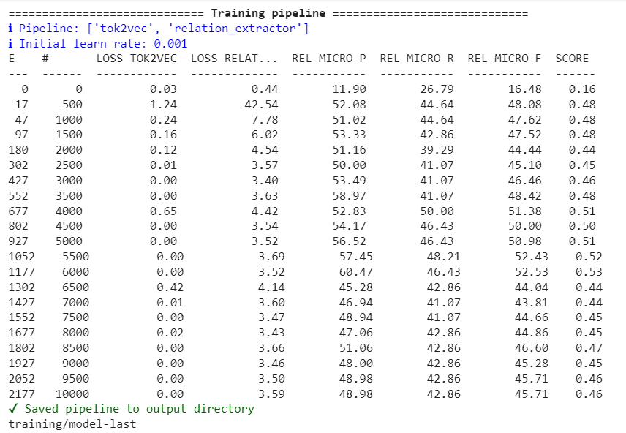
Change transformer =‘bionlp/bluebert_pubmed_mimic_uncased_L-12_H-768_A-12’ in rel_trf.cfg file
CPU Results

Slide 36
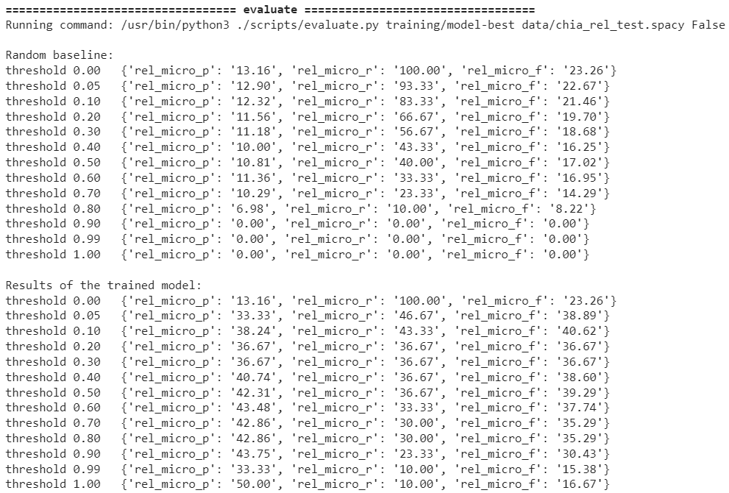

Slide 37
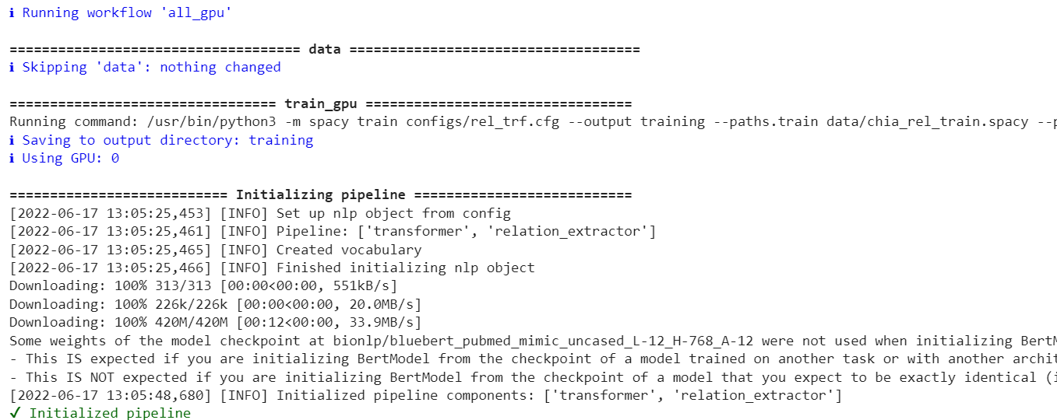
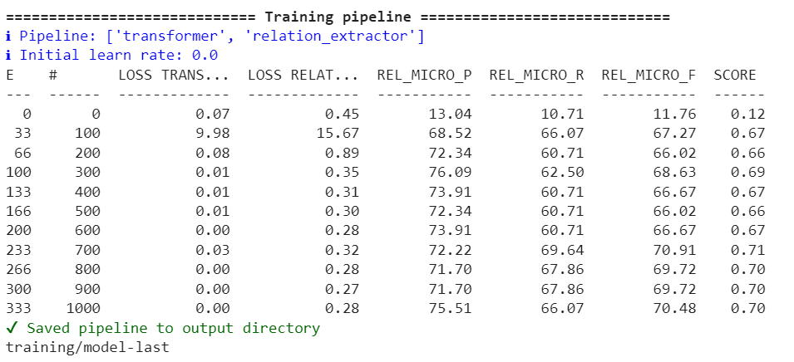
GPU Results

Slide 38
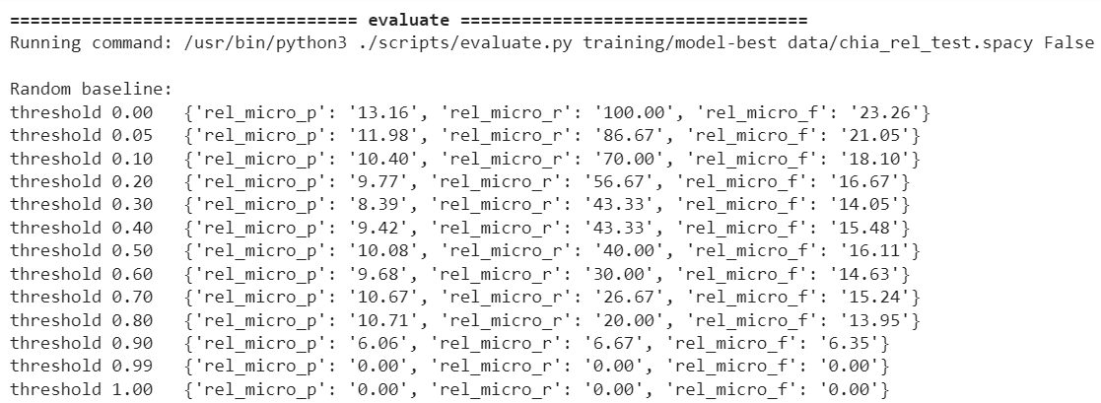
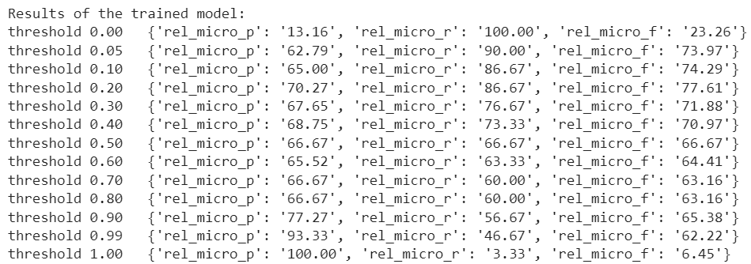

Slide 39
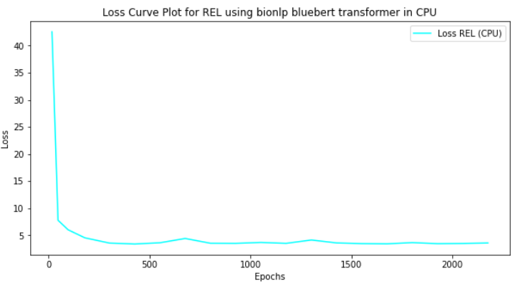
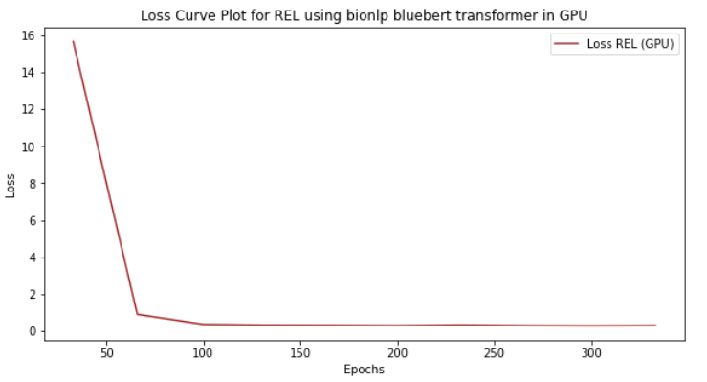
Loss Curve Plots for REL using bionlp bluebert Transformer

Slide 40
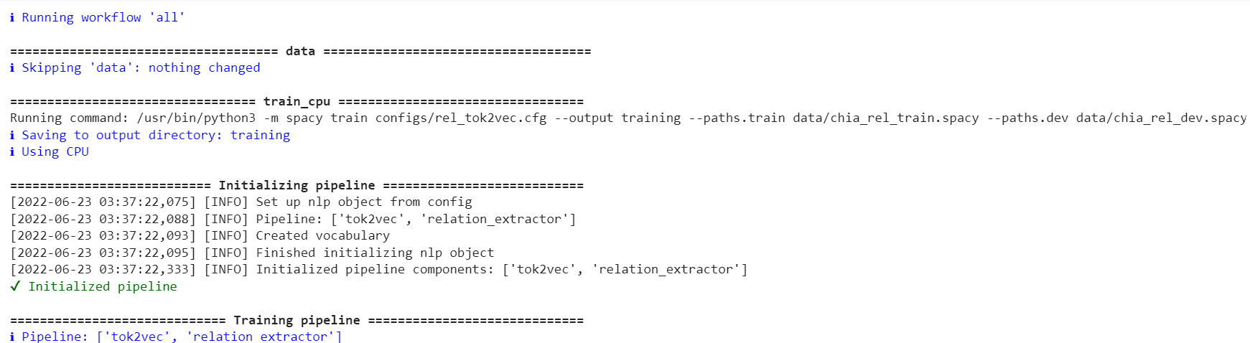

Change transformer =‘roberta-base’ inside the rel_trf.cfg file
CPU Results

Slide 41




Slide 42



GPU Results

Slide 43



Slide 44


Loss Curve Plots for REL using roberta-base Transformer

Slide 45
COMBINED PIPELINE (NER + REL) USING TOK2VEC AND TRANSFORMER
Create a configuration file ner_rel_trf.cfg in /content/drive/MyDrive/chia_clinical_trials/projects/tutorials/rel_component/configs directory
Pipeline used: pipeline = ["transformer", "ner","relation_extractor"]
Traverse to directory /content/drive/MyDrive/chia_clinical_trials/projects/tutorials/rel_component/
Inside project.lock file,
Edit script for train_gpu as
python -m spacy train configs/ner_rel_trf.cfg --output training --paths.train data/chia_rel_train.spacy --paths.dev data/chia_rel_dev.spacy -c ./scripts/custom_functions.py --gpu-id 0
Inside project.yml file, edit the variable,
trf_config: "configs/ner_rel_trf.cfg"

Slide 46

Use the train command to calculate REL F1, Precision and Recall scores
python -m spacy project run all_gpu
GPU Results
Change transformer =‘roberta-base’ inside the ner_rel_trf.cfg file

Slide 47




Slide 48


Loss Curve Plot for Combined pipeline using roberta-base Transformer

Slide 49


Change transformer =‘bert-base-uncased’ inside the ner_rel_trf.cfg file

Slide 50


Slide 51


Loss Curve Plot for Combined pipeline using bert-base uncased Transformer

Slide 52


Change transformer =‘bionlp/bluebert_pubmed_mimic_uncased_L-12_H-768_A-12’ in ner_rel_trf.cfg file

Slide 53


Slide 54


Loss Curve Plot for Combined pipeline using bionlp bluebert Transformer

Slide 55
CONCLUSION
MODELS |  | Performance Metrics |  | GPU
 |  | CPU |  | GPU
NER |  | Tok2VecListener |  | roberta-base |  | bert-base |  | bluebert
 |  | 50% |  | 60% |  | 58% |  | 58%
REL |  | 60% |  | 78% |  | 76% |  | 76%
NER+REL |  | - |  | 97% (NER) 71% (REL) |  | 98% (NER) 70% (REL) |  | 98%(NER) 60%(REL)
For NER model, performance results for training using tok2vec pipeline were 50% using CPU and 60% using GPU
Using transformers, Roberta-base architecture performed better compared to bert-base and bluebert architectures
For REL model, performance results for training using tok2vec pipeline 60% using CPU and 78% using GPU
Using transformers, Roberta-base architecture performed better compared to bert-base and bluebert architectures

Slide 56
THANK YOU

